Slide 1


Nanotechnology and Advanced Materials for Innovative Industry, NanoPl2014
Nanocrystalline structures in steels produced
by heat treatment processes
Krzysztof Wasiak
Faculty of Materials Science and Engineering, Warsaw University of Technology
ul. Wołoska 141, 02-507 Warszawa
Project Manager: Prof. nzw. dr hab. inż. Wiesław Świątnicki
www.nanostal.eu
E-mail: wieslaw.swiatnicki@nanostal.eu
Projekt współfinansowany ze środków Europejskiego Funduszu Rozwoju Regionalnego w ramach Programu Operacyjnego Innowacyjna Gospodarka

Slide 2
Requirements for new steels
The functionality of mechanical structures may be essentially increased by improving the steel properties
AUST.
(TWIP)
Current area of research
-improved strength ⇒ lightness
-increased ductility ⇒ formability
-wear resistance and endurance⇒long time service
-reduced costs of steel and technology
- improved weldability etc…
MARAGING
Source: WorldAutoSteel.org
J.-C. Hell et al. ISIJ Intern. 51 (2011) 1724
STRENGTH
DUCTILITY

Slide 3
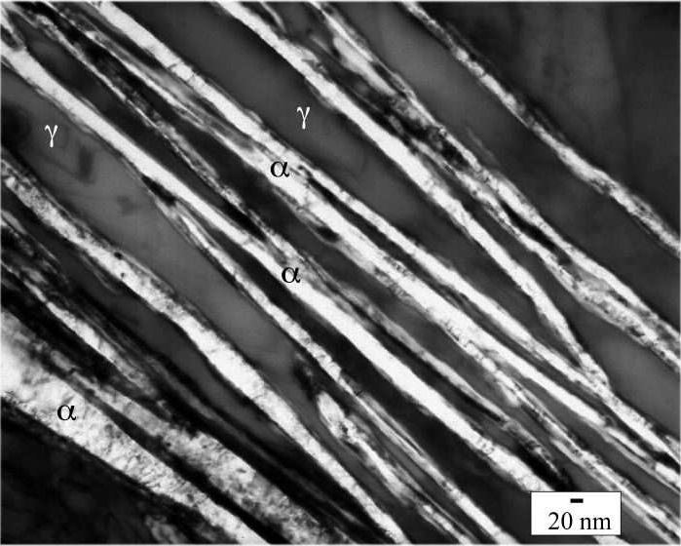
Formation of nanocrystalline structure
in finished components using phase transformations
A nanocrystalline structure was obtained in some steels with specially designed chemical composition using bainitic transformation
Nanomaterial ⇒ material with grain size d≤100nm at least in one direction
Heat treatment: isothermal annealing above the martensitic start temp. (Ms) 190°C÷320°C for the time necessary to finish the bainite transformation
Steel: Fe–0.98%C–1.46%Si–1.89%Mn–0.26%Mo–1.26%Cr–0.09%V (%wt.)
after austempering at 200°C for 5 days
F.G. Caballero, H.K.D.H. Bhadeshia, Curr. Opin.
Solid State Mater. Sci. 8 (2005) 186–193
Thin, nanometric plates of carbide free bainitic ferrite embeded in stable carbon-enriched retained austenite

Slide 4
Problems with implementation of nanobainitic steels for industrial production
Nanobainitic structure was obtained in steels with specially designed (and patented) chemical composition
Long time of isothermal annealing (up to several days) necessary to finish the bainitic transformation.
Lack of effective cooling medium having a temperature in the lower range of bainite transformation: 200÷320°C
A key condition to implement the industrial production
of nanobainitic steel is to develop optimized technology
of nanocrystalline structure formation in (low and medium alloyed steels) various commercially available, standardised steels.
This is an objective of NanoStal Project
carried out in the Faculty of Materials Science and Engineering
at Warsaw University of Technology

Slide 5
Aim of research
One of the objectives of the Project was to produce a nanocrystalline bainitic structure in various commercially available, standardised steels.
Steel chemical composition:
C > 0.4%wt. ⇒ hardenability Ms γ_{r}
Si > 1%wt. ⇒ supression of Fe₃C formation
Mn > 1%wt. ⇒ Ms γ_{r}
Cr > 0.5%wt. ⇒ hardenability
Steels selected for the study
Bearing steel 67SiMnCr6-6-4
Hot work tool steel X37CrMoV5-l
Spring steel 65SiWMn7-4-3
Structural steel 35CrSiMn5-5-4 submitted to carburizing process

Slide 6
Nanobainitic structure of bearing steel 67SiMnCr6-6-4
after austempering in an industrial vacuum furnace
After austenitizing the samples were cooled down to 320°C by blowing pressurized inert gas and then were austempered at this temperature for 6h.
γ_{r}
The nanocomposite structure obtained is composed of nanometric bainitic ferrite plates separated by thin layers of retained austenite
Fot. K. Dudzińska

Slide 7
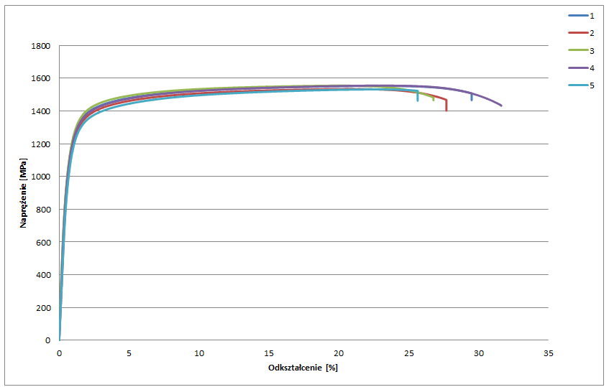
Mechanical properties of bearing steel after austempering heat treatment at 320°C-6h - 67SiMnCr6-6-4
Austempering temperature T_{i}[°C] | Hardness HV2 | KV [J] | R₀₂ [MPa] | R_{m} [MPa] | A [%]
320 | 497 | 17.5 | 1068 | 1542 | 25.4

Slide 8
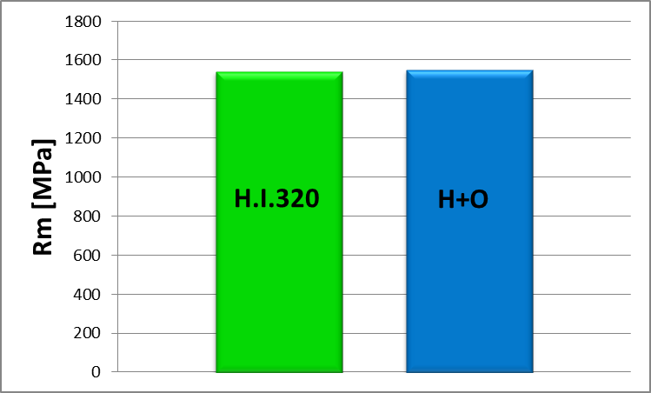
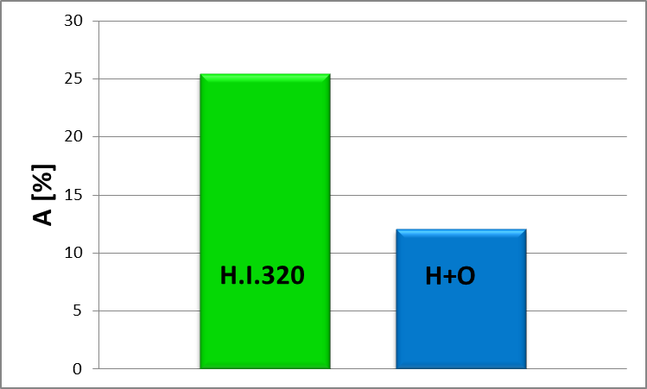
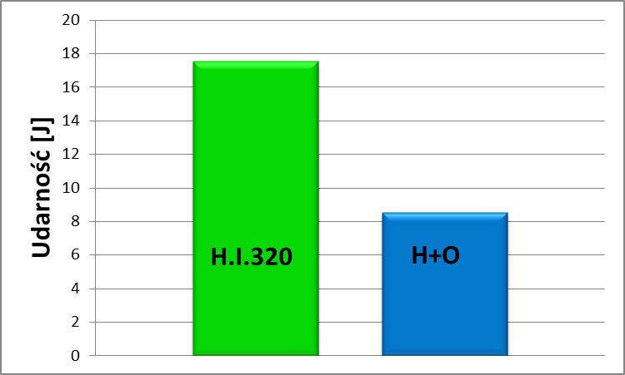
Austempering (H.I.) 320°C
Quenching and Tempering (H+O)
Bearing steel 67SiMnCr6-6-4
Impact strength [J]

Slide 9
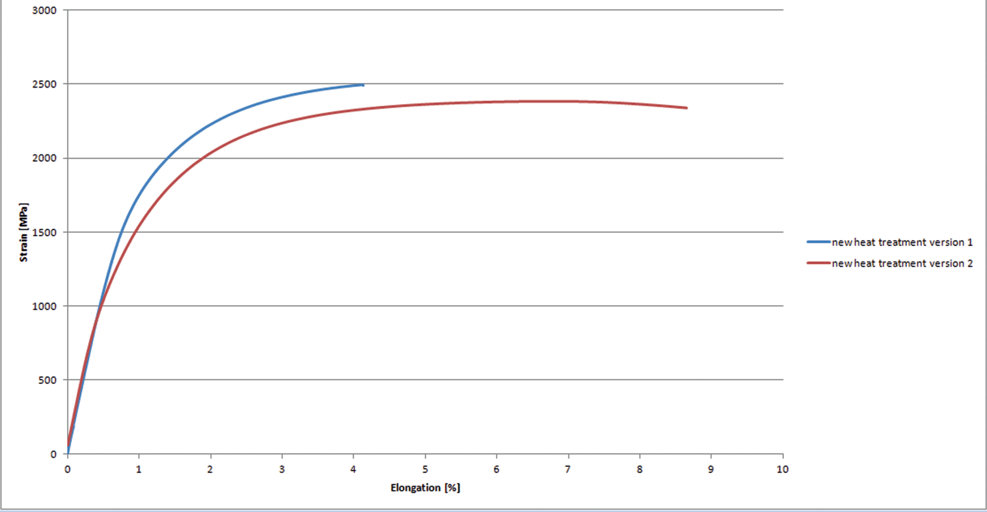
Mechanical properties of nanocrystalline spring steel
65SiWMn7-4-3 after specjal heat treatment
1
2
Treatment variant | Hardness HV2 | KV [J] | R₀₂ [MPa] | R_{m} [MPa] | A [%]
1 | 706 | 10 | 1633 | 2500 | 4
2 | 677 | 12 | 1250 | 2300 | 8

Slide 10
Nanobainitic structure of the carburized surface layer in 35CrSiMn5-5-4 steel after austempering at 320°C-24h
BF
DF
Thickness of ferritic plates: 65 ± 4 nm
Thickness of austenite layers: 26 ± 2 nm
BF
Fot. E. Skołek

Slide 11
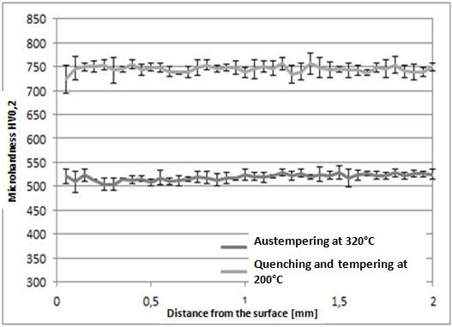
Hardness profiles in the carburized surface layer on 35CrSiMn5-5-4 steel after various heat treatment
Volumetric wear of the carburized surface layers on 35CrSiMn5-5-4 steel after various heat treatment
Surface layers of carburized steel with nanobainitic structure exhibit better wear resistance compared to the layers with tempered martensite obtained by conventional heat treatment in spite of lower hardness
K. Wasiak

Slide 12
Area of research
AUST.
(TWIP)
AUST.
(TWIP)
Current area of research
MAR
MARAGING
Źródła: WorldAutoSteel.org
J.-C. Hell et al. ISIJ Intern. 51 (2011) 1724

Slide 13

Mechanical properties of commercial steels with nanobainitic structure
AUST.
(TWIP)
Present work
○
MARAGING
,
Stal maraging 250: Fe-18.5Ni-7.5Co-4.8Mo-0.4Ti
Stal maraging 300: Fe-18.5Ni-7.5Co-4.8Mo-0.6Ti
Stal typu MS: Fe-0.18C-2Mn-1Cr-0.8Si-0.15(Nb+Ti)

Slide 14
Conclusions
The nanobainitic structure was produced in selected commercial steels by quenching and austempering.
The obtained nanobainite is composed of thin plates of carbide free bainitic ferrite α_{B} separated by layers of stable carbon-enriched retained austenite γ_{r} of nanometric thickness.
The obtained nanobainitic steels have high mechanical properties (HV, R0.2, Rm)
The obtained parameters of strength, ductility and impact strength are similar to those which possess highly alloyed maraging steels

Slide 15

Research Team
Offer laboratory of research and development of modern steel technologies:
DESIGN OF MODERN HEAT TREATMENTS:
• Austempering
• Quenching & Partitioning - Q&P
RESEARH:
• CCT, TTT diagrams
• microstructure
• mechanical and service parameters
• corrosion resistance
MATERIALS EXPERTISE

Slide 16

For more information, please visit our exhibition stand
Exhibition stand: E-92

Slide 17
The results presented in this study have been obtained within the project NanoStal
(contract no. POIG 01.01.02-14-100/09).
The project is co-financed by the European Union from the European Regional Development Fund within Operational Programme Innovative Economy 2007-2013

