Slide 1



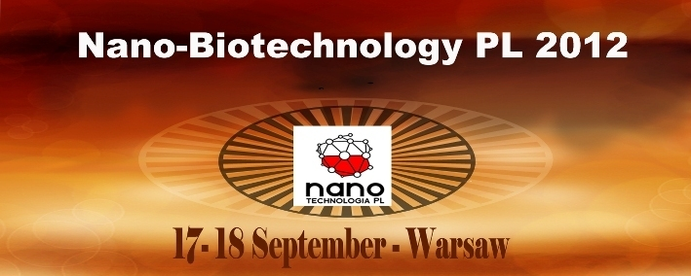
Atomic Force Microscopy (AFM) of polyelectrolyte multilayer systems
Marcin Strawski, Marek Szklarczyk
Magdalena Borkowska, Ludomira Granicka
Notes:
In this presentation we are going to show the results on polyelectrolyte multilayers systems (PEM, polyeletrolyte membranes) studies. Obtained in the layer-by-layer self-organization process (LbL) membranes can be proposed for several applications. One of the most spectacular is the use of PEM in cell transplantation. Encapsulated cells are protected against the immune attack by recipient organism. The respective polyelectrolyte properties which forms the multilayer system has a large impact on the PEM character, while the used membrane will influence the cell, affecting its shape, or changing the form and strength of interaction with the environment. Atomic Force Microscopy (AFM) can help us to characterize several properties of the produced multilayers. The morphology and thickness determination for multilayers based on poly-L-lysine, polyethylenimine and polystyrene sulfonate will be discussed.

Slide 2
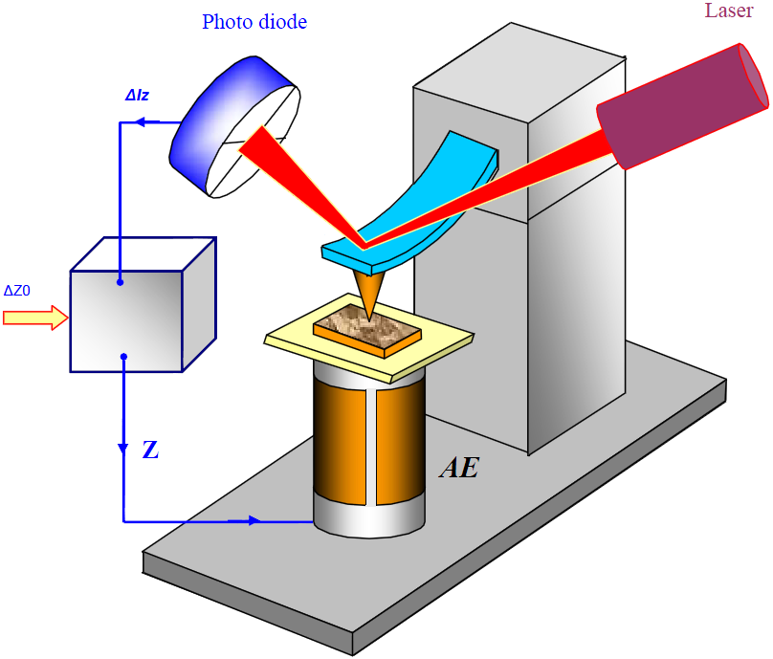
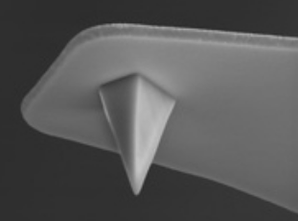

Atomic Force Microscopy (AFM)
Quality of a tip determines the resolution of imaging.
Atomic Force Microscope

Slide 3
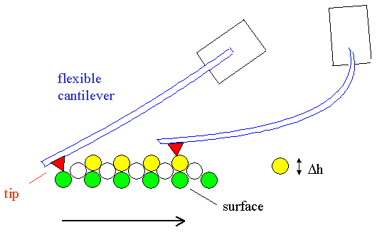
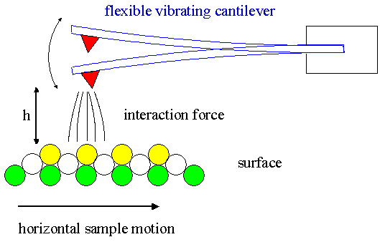
Atomic Force Microscopy (AFM)
Contact Mode AFM
Tapping / Non-contact Mode AFM
Fast, but may destroy surface.
Slow, but suitable for delicate surfaces.
Atomic Force Microscopy (AFM) of polyelectrolyte multilayers systems

Slide 4
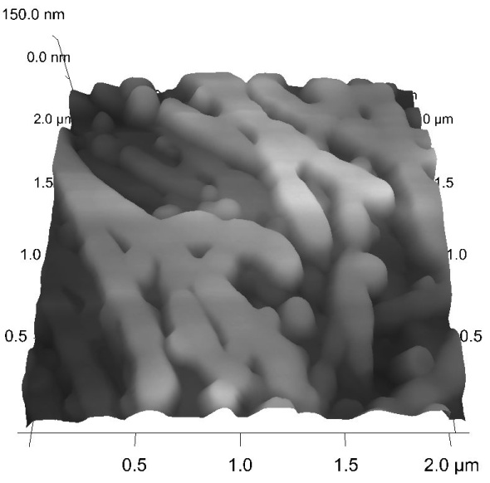
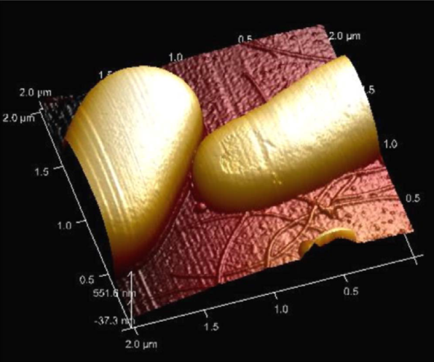
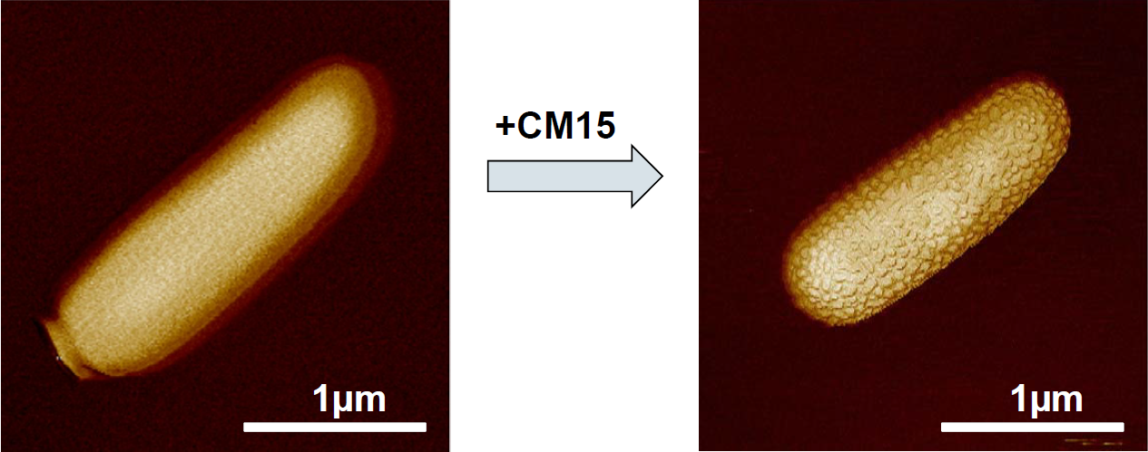
AFM in biology / biotechnology
1,3-disubstituted tetrahydro-b-carboline amino acid base peptide nanostructures.
M. Strawski, K. Pułka research.
Escherichia coli*
Cecropin-melittin - Antimicrobial Peptides*
* Images taken from the „Advances in AFM for Microbiological Research” Bruker Webinar series.

Slide 5
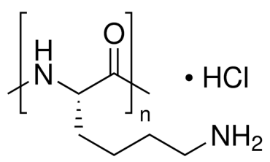
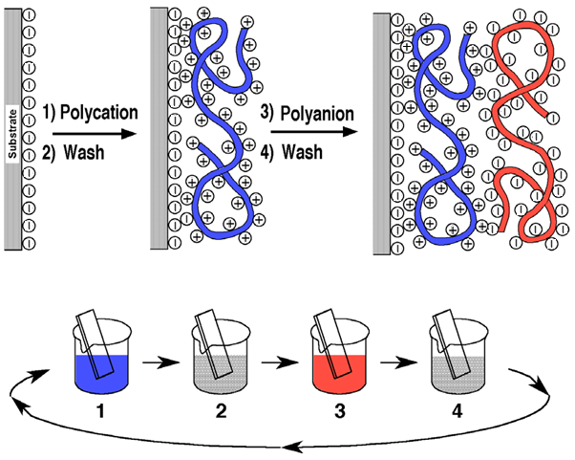
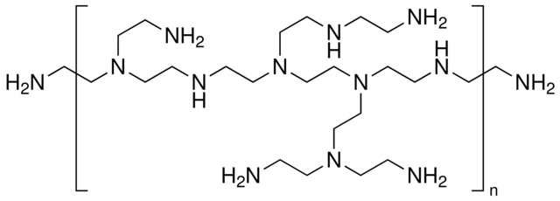
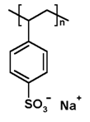
Polyelectrolyte multilayers (PEM)
Poly-L-Lysine (PLL) [+]
Polyethylenimine (PEI) [+]
G. Decher, Science 277, 1232-1237 (1997)
Polystyrene sulfonate (PSS) [-]

Slide 6
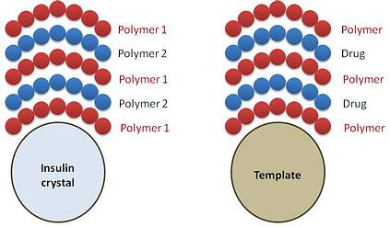
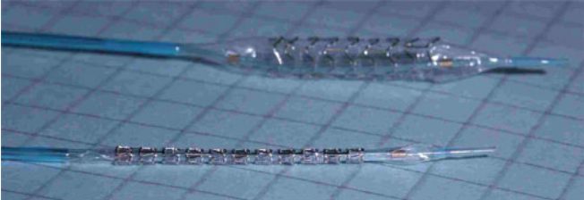
PEM – why so interesting
PEM can be used:
Creation of capsules for Targeted Drug Delivery
Hydrophilic and Antibacterial Coatings of medical instrumentation
Cell coating – immunoisolation – transplantation
Capsulation®
Balton® stents
Cell

Slide 7
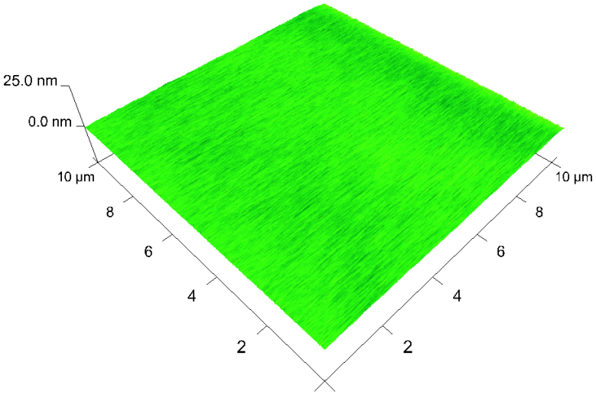
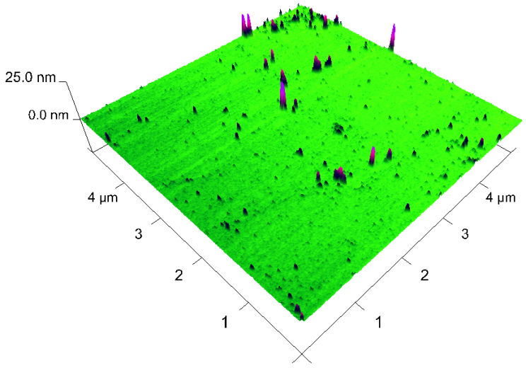
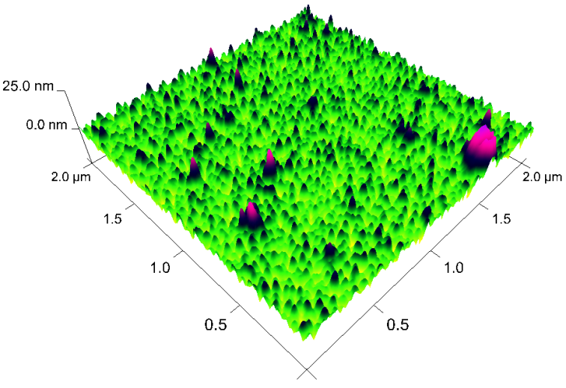
Atomic Force Microscopy of PEM
Top left: mika surface
Top right: PLL/PSS
Bottom right: (PLL/PSS)₅
Notes:
MIKA
(PLL/PSS)1
(PLL/PSS)5

Slide 8
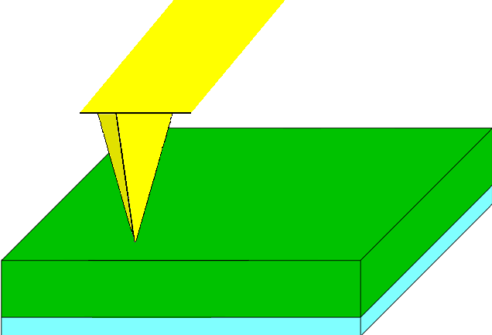
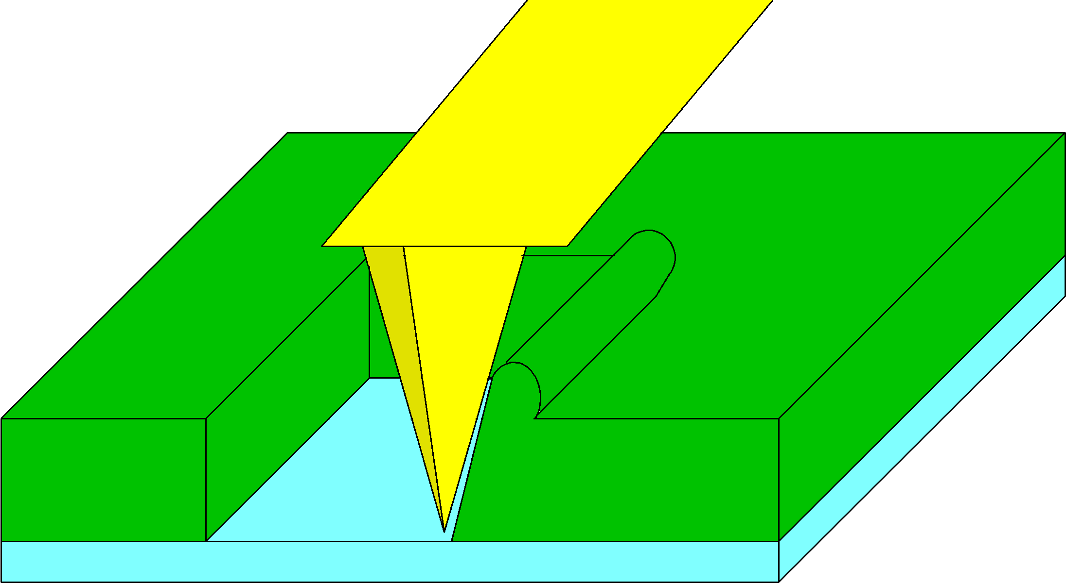
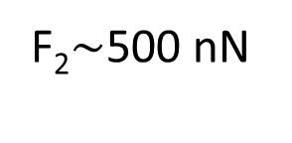
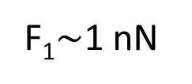
Nanolithography of PEM
F₁$\sim$1 nN
F₂$\sim$500 nN
High-value force applied to a tip removes the soft organic deposit from the surface.

Slide 9
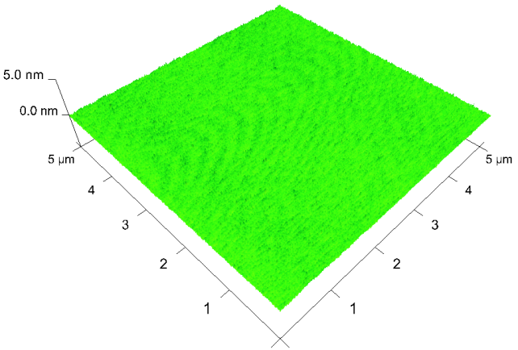
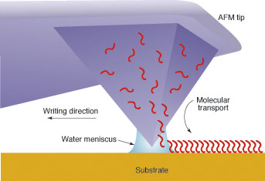
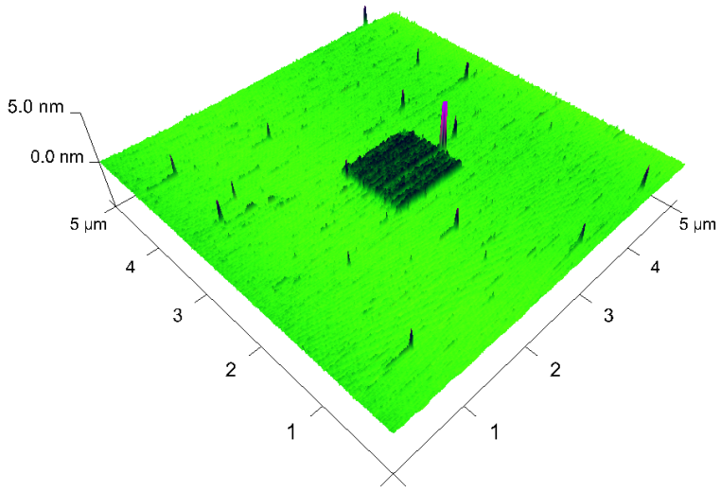
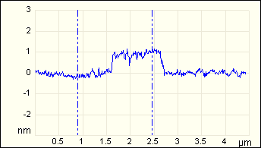
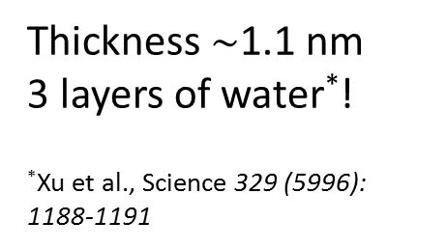
Nanolithography of PEM
Mica surface
Dry enviorment
litography
Humid enviorment
litography
Dip-pen lithography
Thickness $\sim$1.1 nm
3 layers of water*!
*Xu et al., Science 329 (5996): 1188-1191
Notes:
Czy nie niszsczymy substratu?
Dip-pen lithography

Slide 10
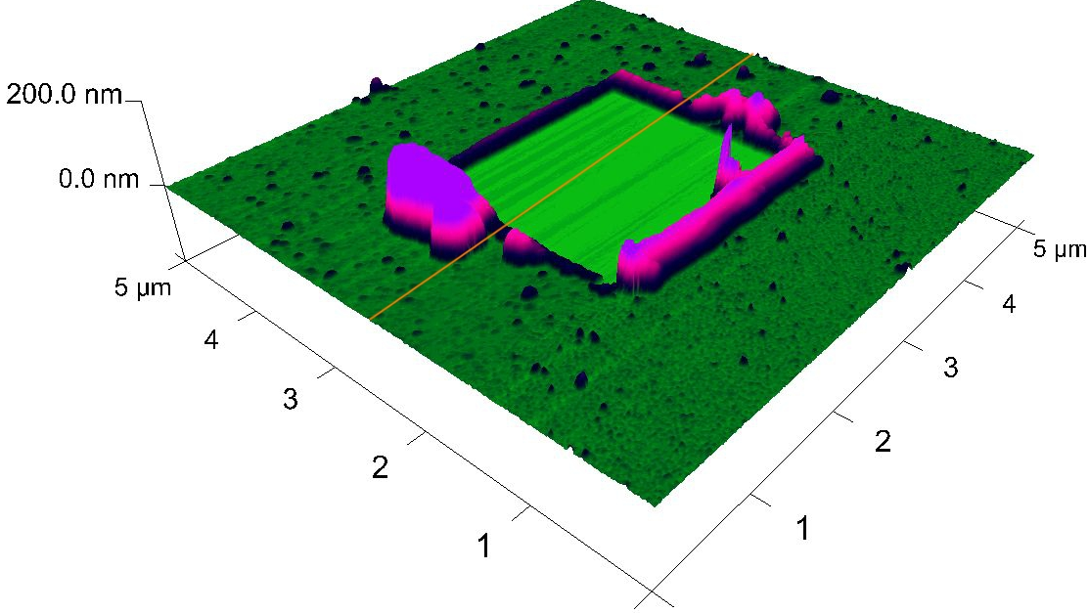
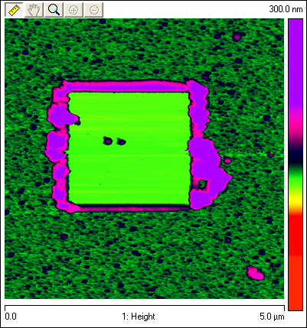
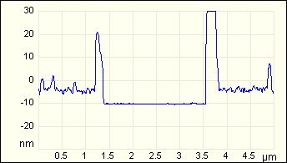
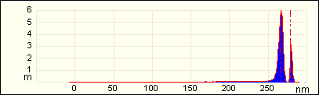

Nanolithography of PEM
The average thickness of a polyelectrolyte multilayer can be easily determined
Cross-section tool
Depth distribution histogram tool

Slide 11
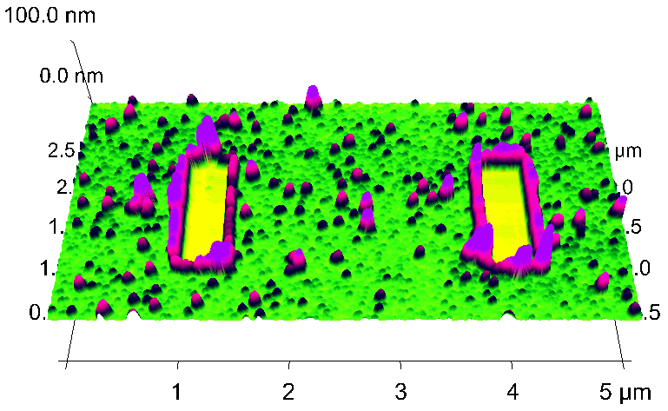
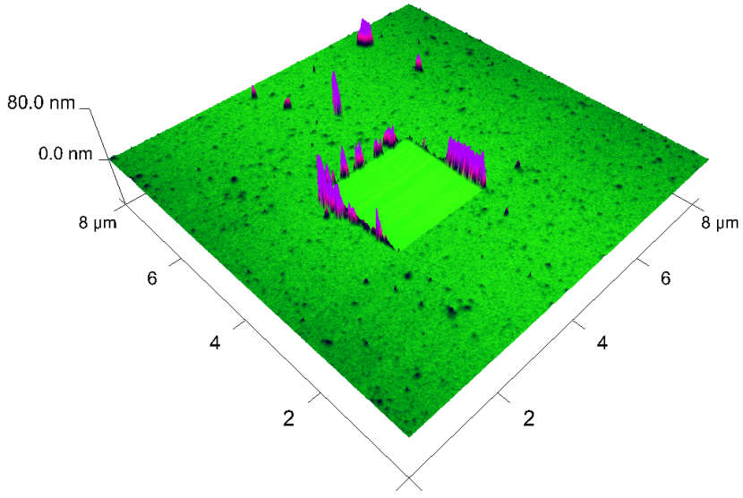
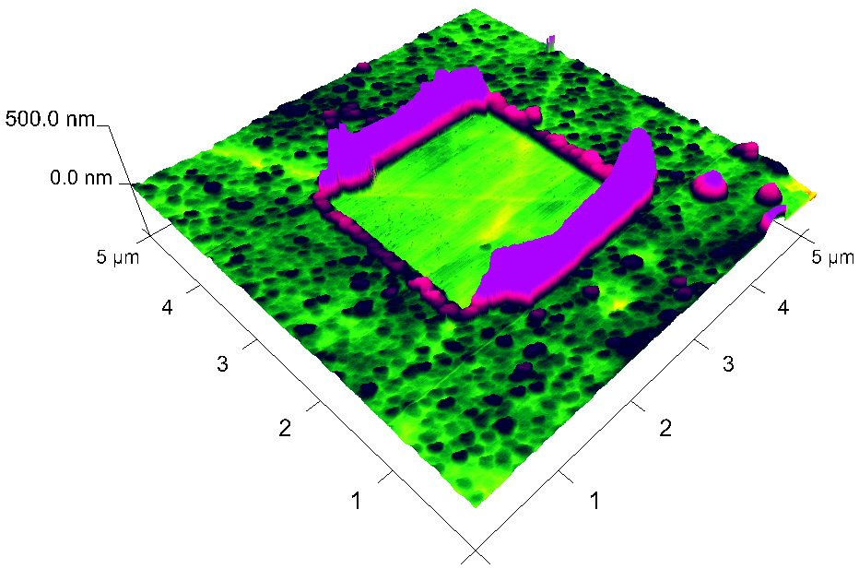
Nanolithography of PEM
1 layer of PEI
on mica
2 bilayers of PEI/PSS on mica
5 bilayers of
PLL/PSS on platinum
Notes:
Pei-F (Pei-F/PSS)2 platyna(PLL/PSS)5

Slide 12
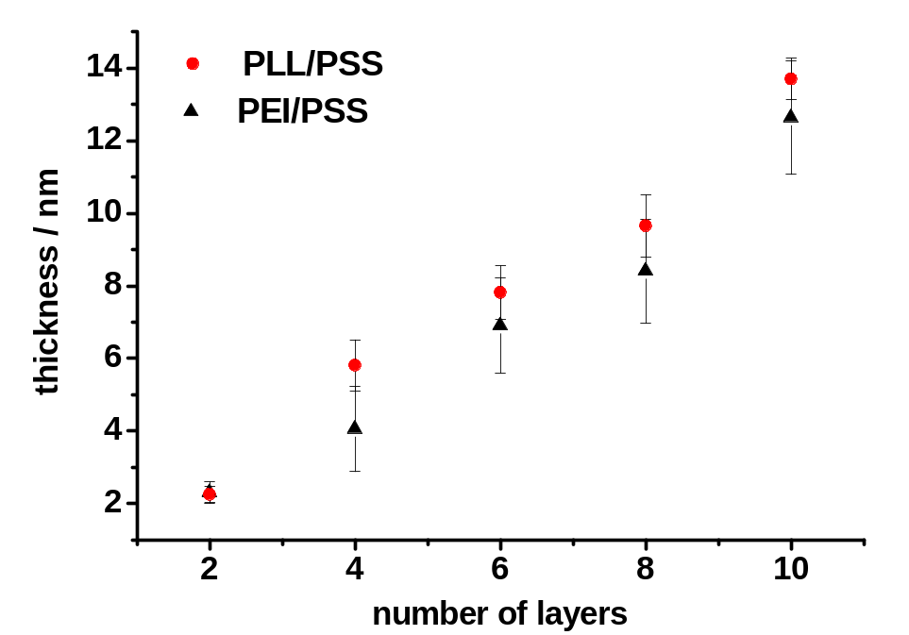
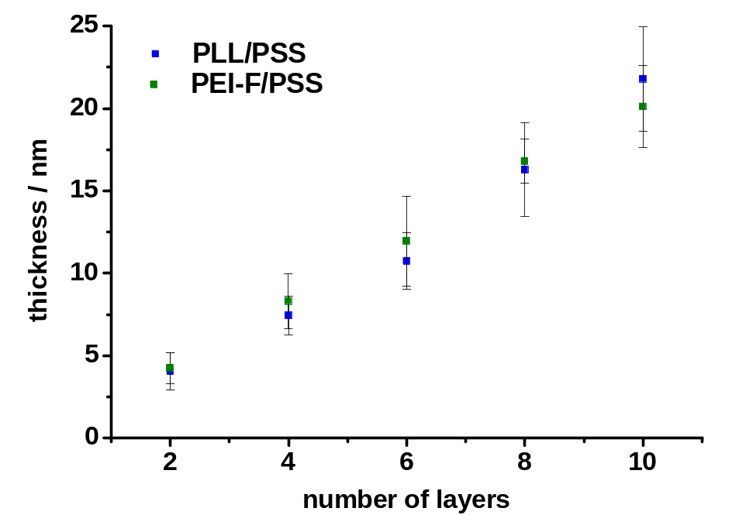
Nanolithography of PEM
Mica surface
Platinum surface

Slide 13
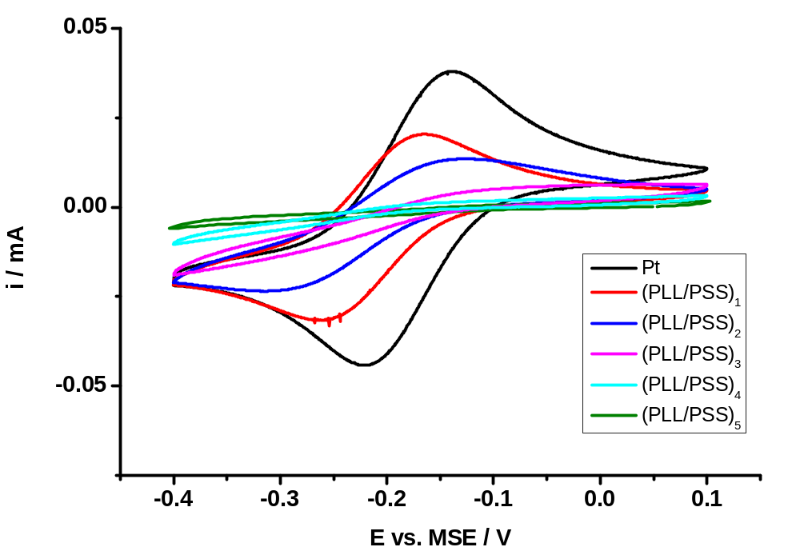
Transport through the PEM
Fe(CN)₆³⁻
Metal electrode
Fe(CN)₆⁴⁻
PEM
Electrochemistry of ferricyanide on platinum electrode without (black curve) and with PEM coverage (colored curves).

Slide 14
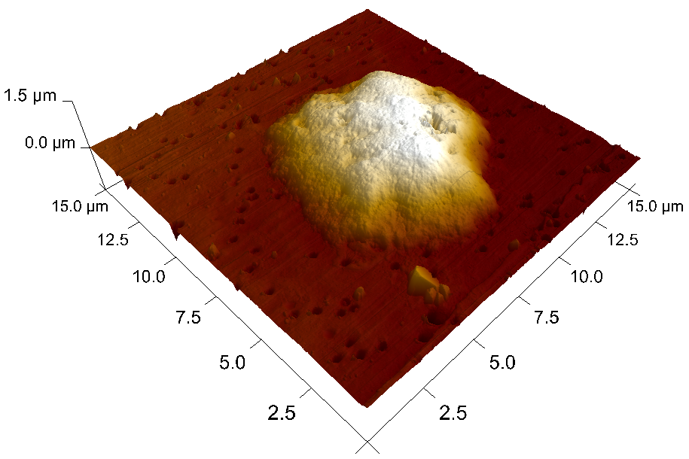
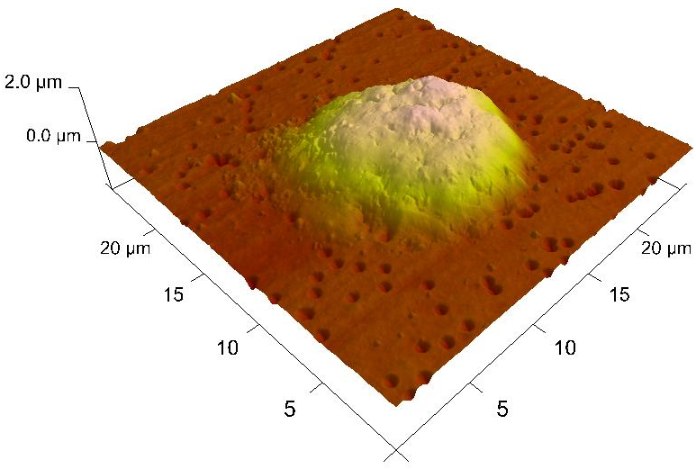
AFM in nanobiotechnology
HL-60 cell deposited on filtration membrane
HL-60 cell coated with PEM layer deposited on filtration membrane

Slide 15


Acknowledgements
Magdalena Borkowska, Ludomira Granicka
Marek Szklarczyk
Students:
Kamil Niedbała, Joanna Koprjaniuk, Anna Maria Dąbrowska
Financial support: MNiSW Grant no. N N401 592840, University of Warsaw grant no. 501/86-DSM-100100

Slide 16
Conclusions
Atomic Force Microscopy (AFM) is a versatile tool for imaging in nanometer scale including biology and biotechnology objects.
The morphology of various polyelectrolyte multilayers (PEM) can be monitored to confirm the surface coverage.
AFM-based method of nanolithography can be used to obtain the information about the thickness of PEM systems.

